Slide 1
WHERE 40 ANALYST HOURS GO
Targeting the team's weekly capacity where analytical work
actually changes outcomes.
Talay Kamali · Analytics Skills Challenge · May 2026
Data sources: ACNC AIS 2020 · ACNC Charity Register (data.gov.au)

Slide 2
THE FRAMING
Analyst hours aren't dollars.
THE COMMON FRAMING
OUR FRAMING
"Which charities need the most help?"
"Where does 40 hrs/week of analytics actually move outcomes?"
Treats every form of help as interchangeable. A donation, a delivery shift, and a regression model all become the same input. The answer collapses to: the biggest gap.
Treats analyst time as a specific resource matched to charities where analytical capacity is the bottleneck — not generic need.
Talay Kamali · Charity Analytics Challenge

Slide 3
SECTOR SNAPSHOT
22,506 eligible charities. Small, volunteer-driven, fragmented.
22,506
861K
$3.9B
77%
Eligible charities
Volunteers
Combined revenue
Classified as Small
WHAT THE DATA TELLS US
Three-quarters of registered charities are Small, run by volunteers, and operate without in-house analytical capacity.
Their median paid FTE is near zero. Their median volunteer count is 10. The gap between mission and measurement is exactly the gap analyst hours can fill — not money, not labor.
Source: ACNC AIS 2020 + Charity Register, filtered to active, registered, revenue-positive, non-religion-only, Small/Medium charities.

Slide 4
METHODOLOGY
Four pillars, weighted by intent.
Every charity scored 0–100 on each pillar. Composite is a weighted sum reflecting the team's intent.
30%
25%
25%
20%
IMPACT
CAUSE
LEGITIMACY
CAPACITY GAP
Volunteer count, leverage ratio, geographic spread, beneficiary count.
Weighted toward acute need: homelessness, disability, Aboriginal/TSI, disaster victims.
Positive net assets, low admin ratio, years of operation.
Small/Medium size, low paid FTE, has a website. Where analyst hours actually fit.
Eligible pool: active, registered, revenue > 0, Small or Medium, non-religion-only. 22,506 charities scored.
Sensitivity check: switching to equal weighting retains 8 of the top 10. Ranking is robust to weighting choice.

Slide 5
TOOLCHAIN
Python for modeling. Tableau for the story.
PYTHON
TABLEAU
pandas, numpy
calculated fields, parameters
Joined AIS 2020 + Charity Register on ABN (44,843 matches), engineered 4 pillar features, scored 22,506 eligible charities, sensitivity-tested weights, exported to CSV.
Three dashboards: sector context, the ranked shortlist with pillar breakdown, and a parameter-driven profile drill-down.
Alteryx scoping note: the same pipeline maps cleanly — Input → Join (ABN) → Formula tools per pillar → Score → Filter Top 10 → Output. Tableau and Python were chosen to demonstrate code-level reproducibility.

Slide 6
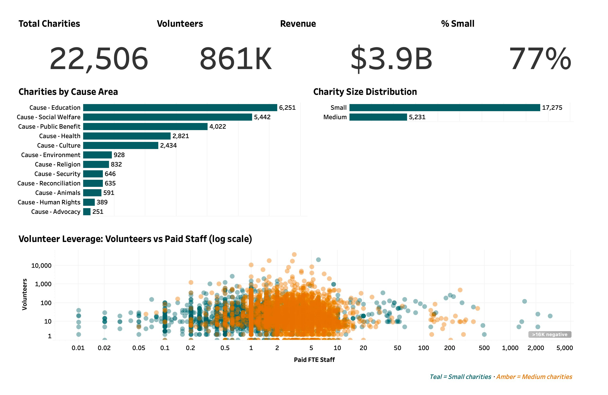
DASHBOARD 1
Sector Snapshot
Open in Tableau Public →

Slide 7
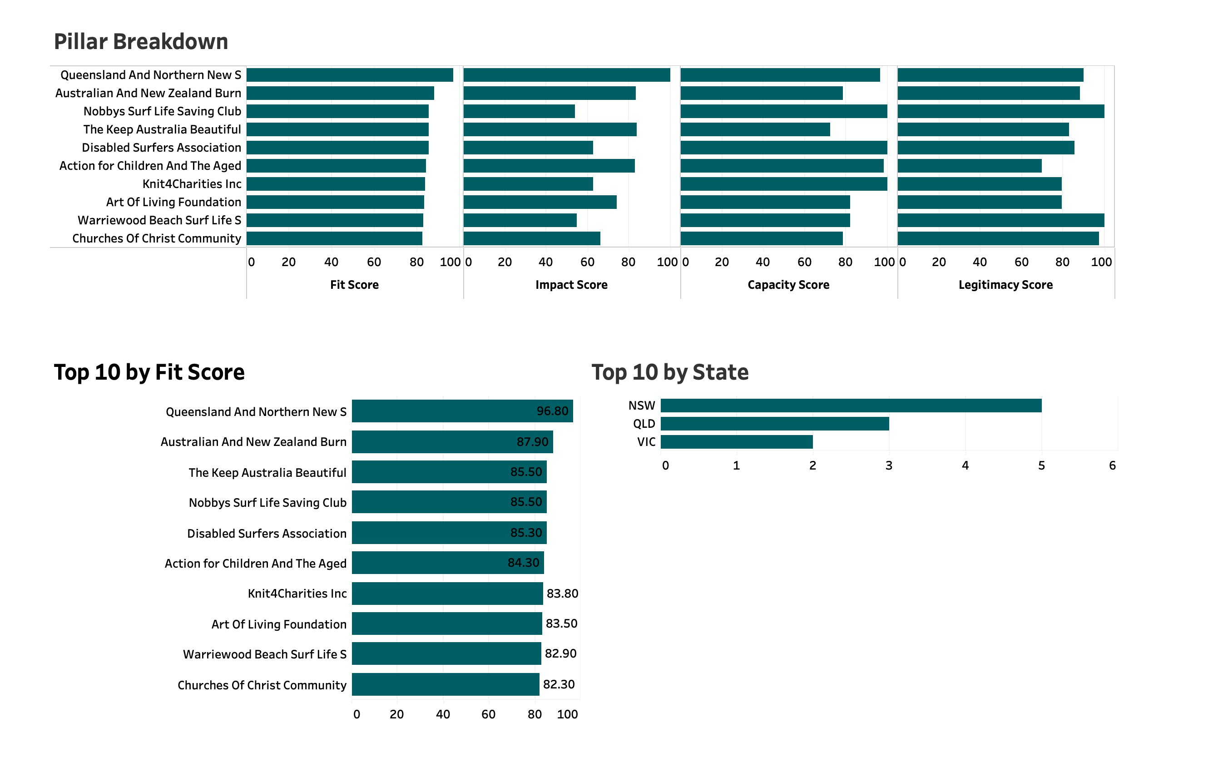
DASHBOARD 2
The Shortlist
Open in Tableau Public →

Slide 8
THE RECOMMENDATION
The team should contact these ten.
RANK
CHARITY
STATE
FIT SCORE
1
Queensland & Northern NSW Lions Medical Research Foundation
QLD
96.8
2
Australian & New Zealand Burn Association
NSW
87.9
3
Nobbys Surf Life Saving Club
NSW
85.5
4
Keep Australia Beautiful (VIC)
VIC
85.5
5
Disabled Surfers Association of Australia
NSW
85.3
6
Action for Children and the Aged (ACATA)
QLD
84.3
7
Knit4Charities
QLD
83.8
8
Art of Living Foundation
NSW
83.5
9
Warriewood Beach Surf Life Saving Club
NSW
82.9
10
Churches of Christ Community Care
VIC
82.3
Top 10 of 22,506 eligible charities. Score range 82.3–96.8. Composite fit score on 0–100 scale.

Slide 9
FEATURED #1
Queensland & Northern NSW Lions
Medical Research Foundation
QLD · Small · 45 years operating · Fit Score 96.8
100
IMPACT SCORE
96.6
CAPACITY SCORE
1,000 volunteers, multi-state reach, 23 beneficiary groups served.
Small org with near-zero paid FTE — exactly where analyst hours close a real gap.
89.9
LEGITIMACY SCORE
$156K
ANNUAL REVENUE
Positive net assets, 45 years of continuous operation, transparent financials.
Resource-constrained but operationally solid — leverage point, not lost cause.
Read-out: the only top-10 charity to score in the top decile on all four pillars.

Slide 10
WHAT 40 HOURS LOOKS LIKE
The shortlist is the who. Here's the what.
Each top-10 charity gets analytical work matched to what their data shows they do — not generic spreadsheets, not pro-bono "help."
Medical Research
Health & Burns Association
Grant ROI dashboard, donor cohort retention model
Patient outcome tracking, peer-benchmark visualization
Surf Life Saving Clubs
Environmental (Keep Australia Beautiful)
Volunteer-hour productivity, incident heatmaps by beach
Site-prioritization model, campaign reach attribution
Disabled Surfers Association
Aged & Children Charities
Participant journey analytics, event ROI per region
Service-gap mapping, demand forecasting
Knit4Charities
Wellness / Foundations
Volunteer matching, output-distribution optimization
Program attendance funnels, retention cohort analysis
Every deliverable is reproducible from the AIS data feed. No new data collection required to start.

Slide 11
HONEST TRADEOFFS
What this model doesn't see.
Self-reported data
AIS figures are submitted by charities themselves. Verification depends on ACNC audit cycles, not real-time checks.
2020 financials
The AIS dataset is from 2020. A handful of top-10 charities may have changed substantially since then; first contact will confirm current state.
Cause weighting is editorial
Acute-need weighting reflects judgment, not data. Sensitivity check shows 8 of 10 stay top-ranked under equal weighting.
No qualitative signal
Score doesn't measure leadership, culture, or willingness to accept external help. Step 2 of contact must surface this.
Recommended next step: outreach to top 10, scoped pilot with the #1, then expand based on engagement.

Slide 12
THE RECOMMENDATION
Contact the top 10. Start with Queensland & Northern NSW Lions Medical Research Foundation.
Talay Kamali · May 2026
Code: github.com/talaygh · Dashboard: published to Tableau Public

